Slide 1

Diamond Dataset Analysis Project
Paul Flanagan

Slide 2
Introduction
Sample provided by ggplot2
Records of over 50,000 diamonds

Slide 3
Overview of Variables
Self explanatory:
price – $
x, y, z – dimensions, mm

Slide 4
Carat
Measurement of diamond’s weight
1 carat = 0.2 grams

Slide 5
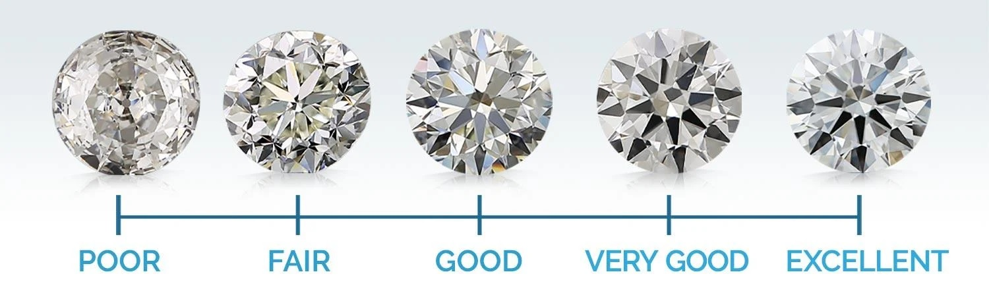
Cut
How gem has been cut to diffract light
Fair < Good < Very Good < Premium < Ideal

Slide 6
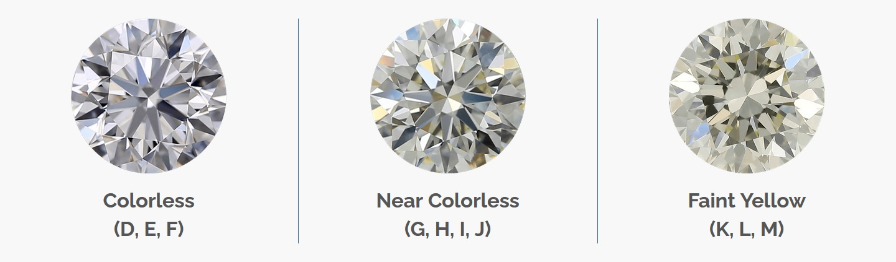
Color
Hue of the Diamond
J < I < H < G < F < E < D

Slide 7
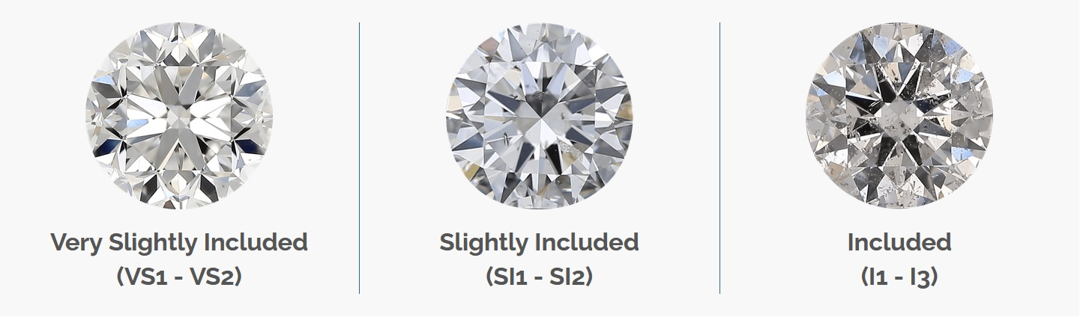
Clarity
Presence of scratches or blemishes inside diamond
I1 < SI2 < SI1 < VS2 < VS1 < VVS2 < VVS1 < IF

Slide 8
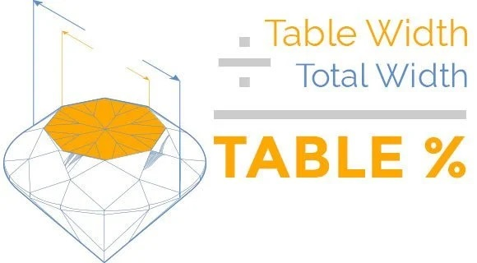
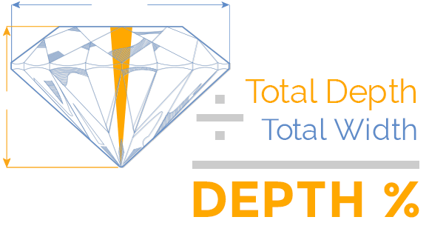
Table and Depth
Percentage measurements
Calculated based on other measurements

Slide 9
Hypothetical Client
Braunschweiger Jewelers, Morristown-based store
Data analysis will allow them to better manage their inventory

Slide 10
Question 1
What are the standard dimensions of a diamond in this dataset?

Slide 11
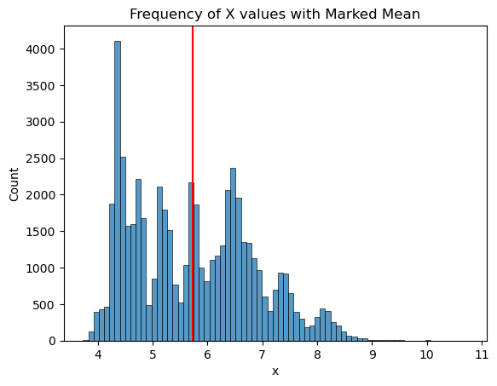
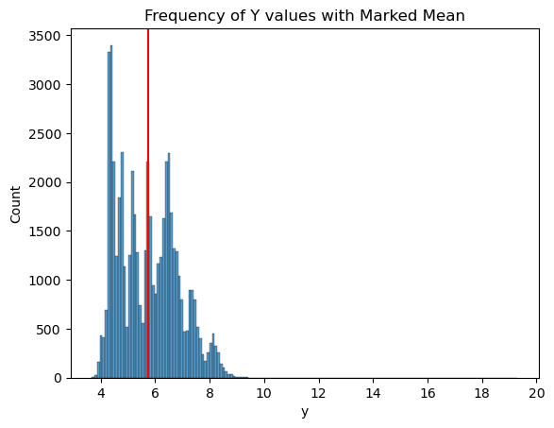
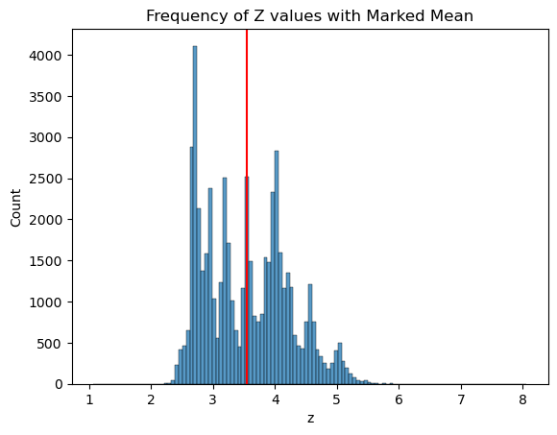
Standard Dimensions
Average:
5.73mm x 5.73mm x 3.54mm
Most outliers on upper end

Slide 12
Question 2
What is the distribution of carat sizes typically circulating in the market?

Slide 13
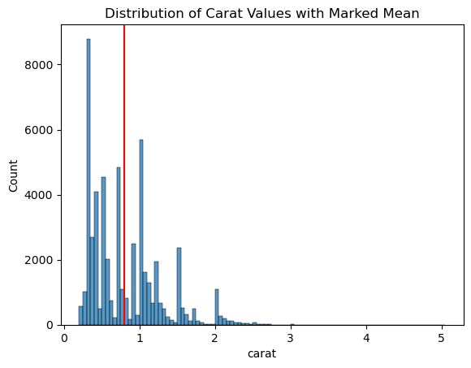
Distribution of Carat Sizes
Mean is around 0.75 carats
Average wedding stone size

Slide 14
Question 3
How are the tiers of quality attributes distributed?

Slide 15
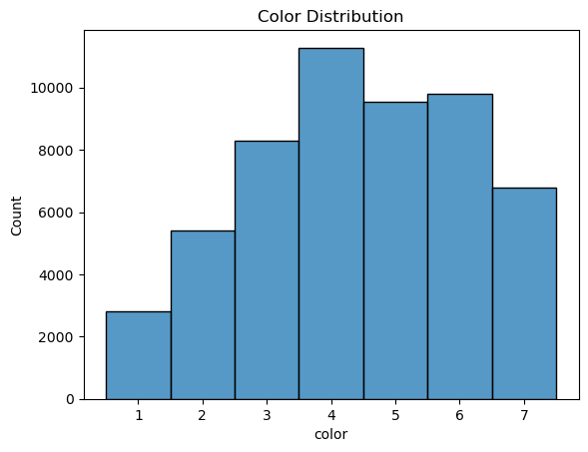
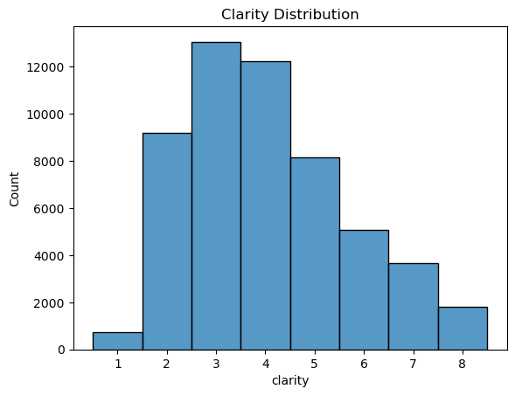
Quality Distribution – Color and Clarity
Color is centrally distributed,
Clarity trends toward lower end
Suggests it may be easier to sell a
diamond with good color but poor clarity
than vice versa

Slide 16
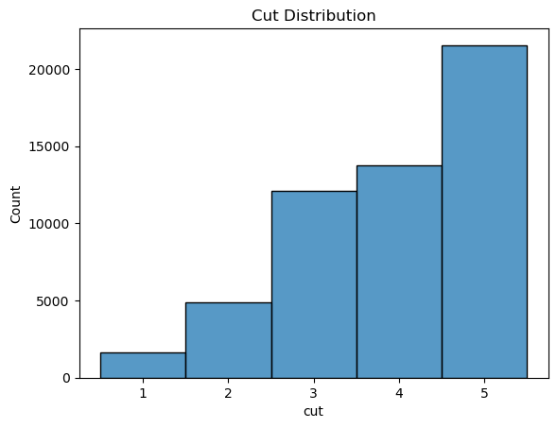
Quality Distribution - Cut
Plurality have highest tier cut
Cut is only feature not innate to the
diamond – instead determined by
skill of the gem cutter

Slide 17
Question 4
How rare are the highest tiers of quality in a diamond?

Slide 18
Rare Diamonds
Checked for how often the top tiers of quality coincided
Calculated programmatically
Sorted out diamonds with one, two, and three of these attributes
Found out how many and what portion satisfied requirements

Slide 19
Rare Diamonds
Total Diamonds: 53920
At least one maximum quality: 26021 (48.26%)
At least two maximum qualities: 4063 (7.54%)
All three maximum qualities: 28 (0.05%)

Slide 20
Question 5
How does a diamond's value correlate with each of the main attributes?

Slide 21
Greatest Value Impact
Plotted each attribute against price
Looked for positive correlations

Slide 22
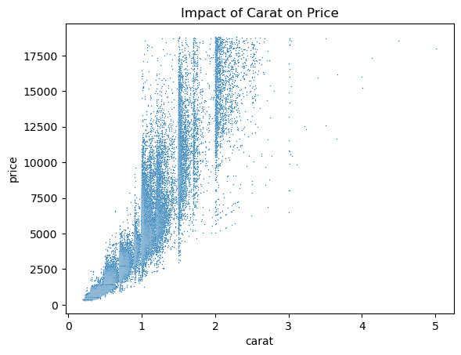
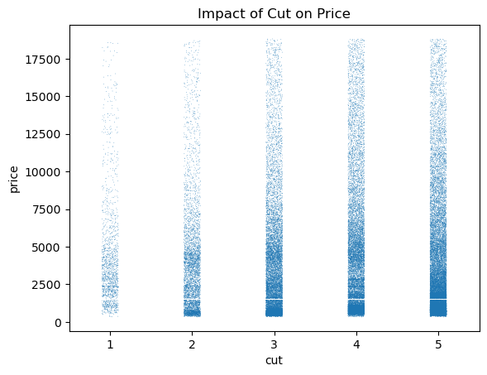
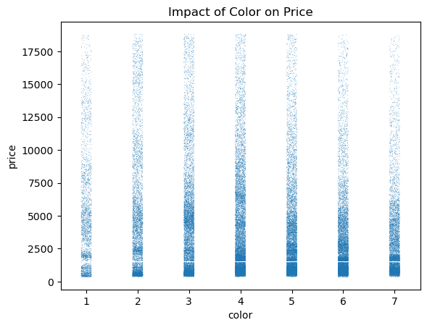
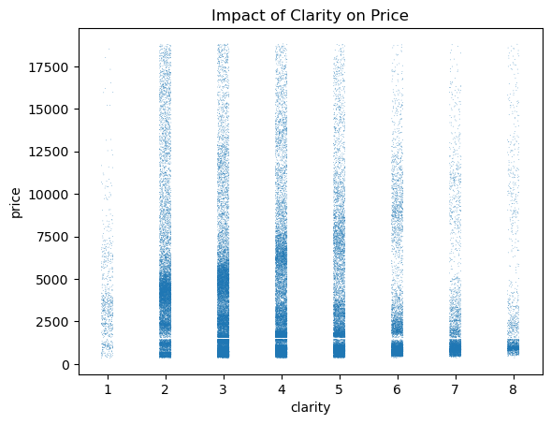
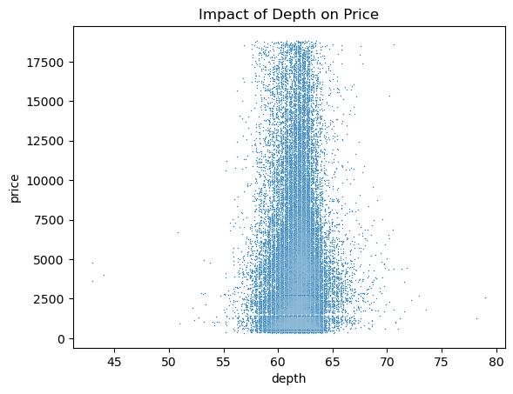
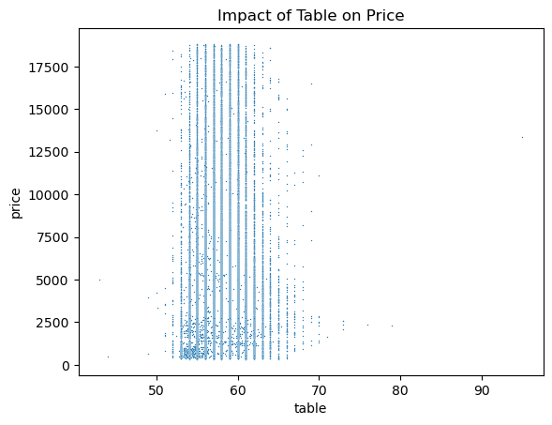

Slide 23
Greatest Value Impact
Most obvious correlation from carat
Minor correlation with cut, but not as pronounced

Slide 24
Future Work
More in-depth analysis of attributes’ impact on price
Potentially building model to predict diamond price

